Slide 1
Introduction to Programming
Lesson 4: Strings and Arrays

Slide 2
Table of Contents
C# Strings
C# Arrays

Slide 3
C# Strings

Slide 4
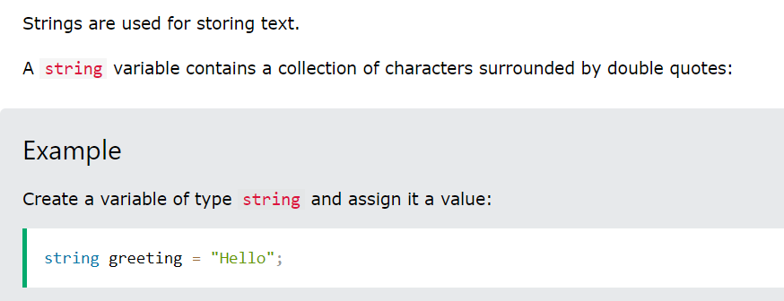
C# Strings

Slide 5
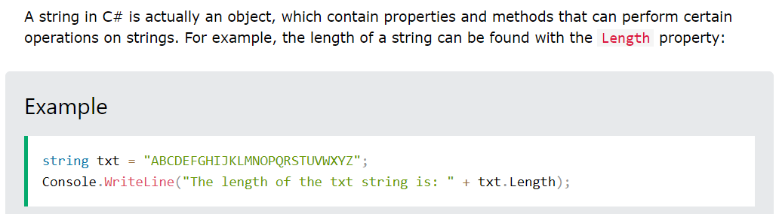
String Length

Slide 6
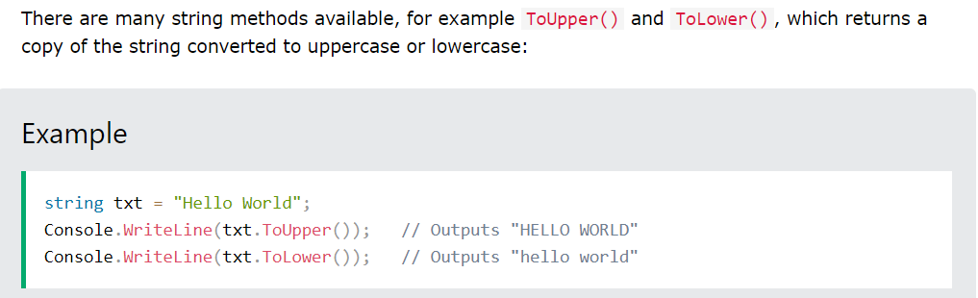
Other Methods

Slide 7
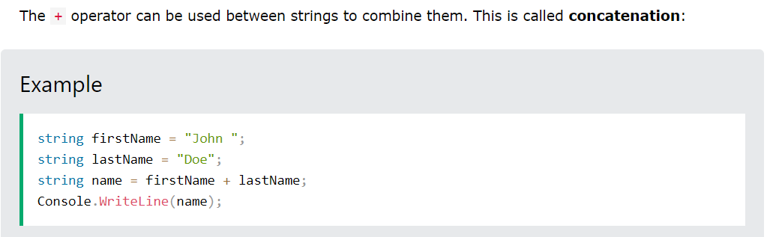
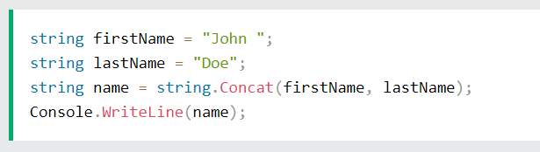
String Concatenation

Slide 8
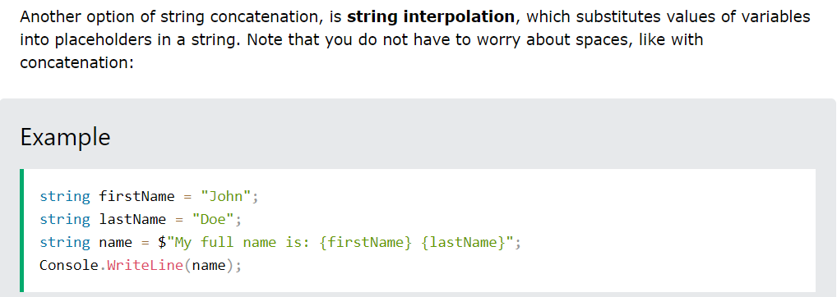
String Interpolation

Slide 9
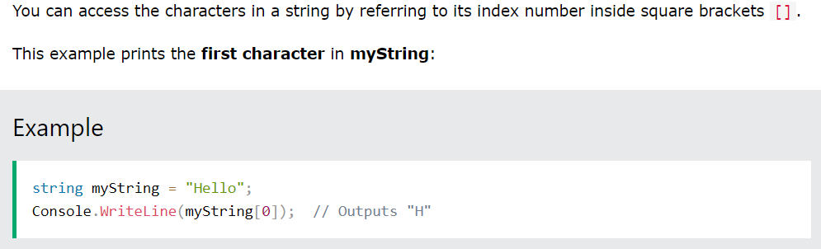
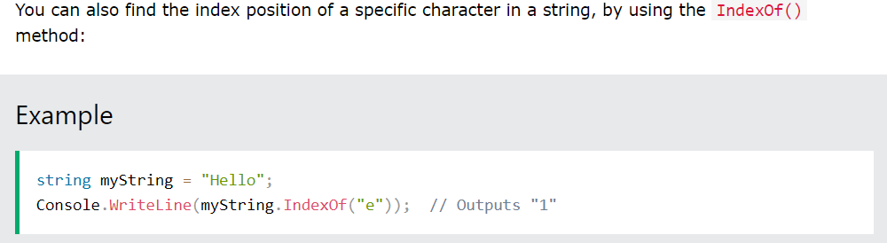
Access Strings

Slide 10
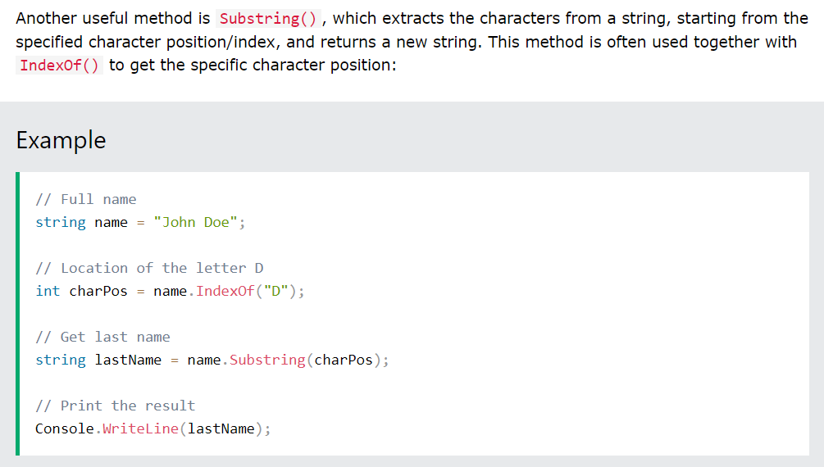
Access Strings

Slide 11
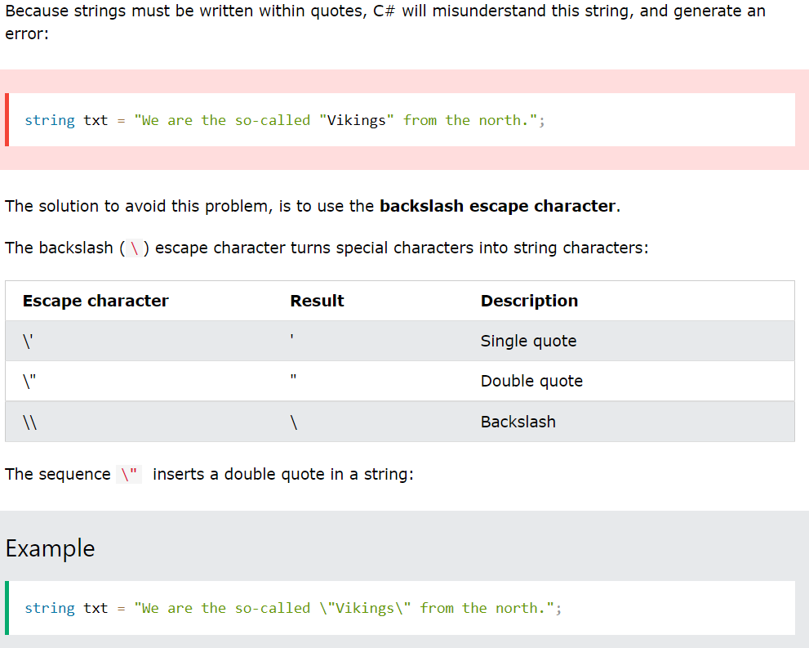
Special Characters

Slide 12
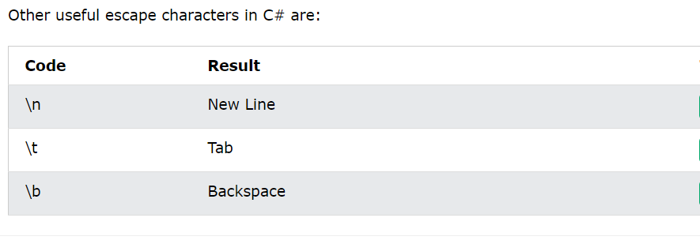
Special Characters

Slide 13
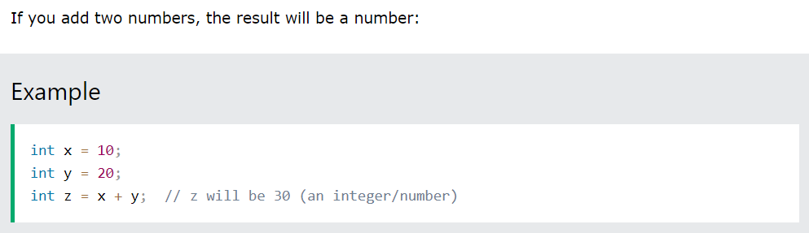
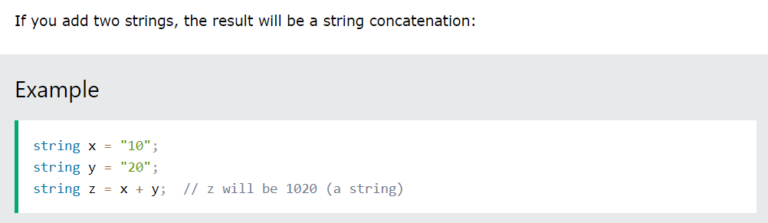
Adding Numbers and Strings

Slide 14
C# Arrays

Slide 15
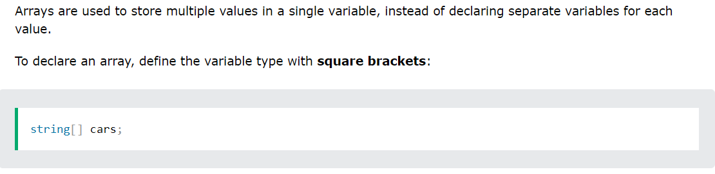
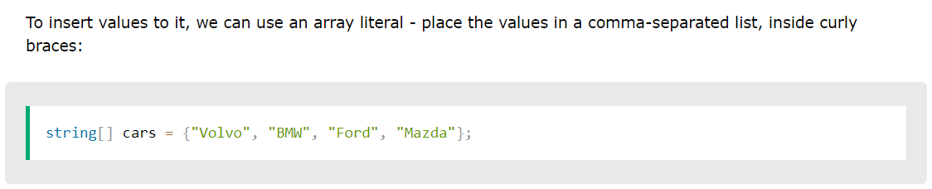
Create an Array

Slide 16
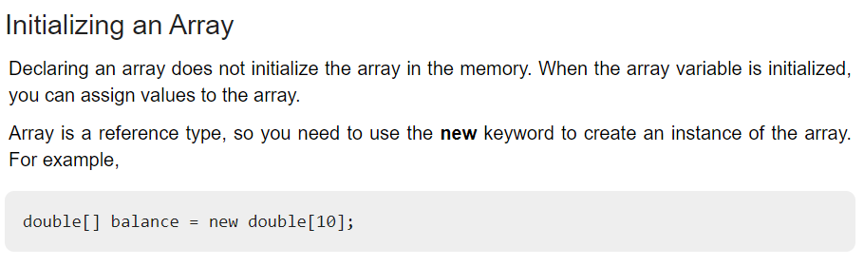
Create an Array

Slide 17
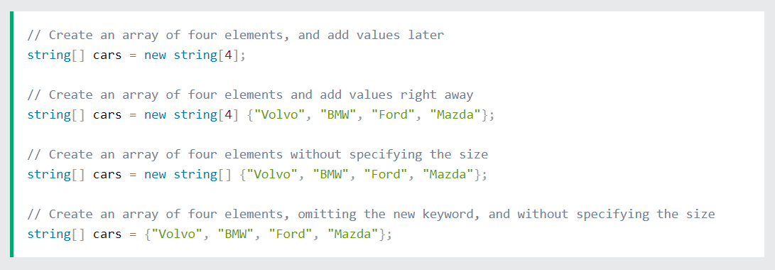
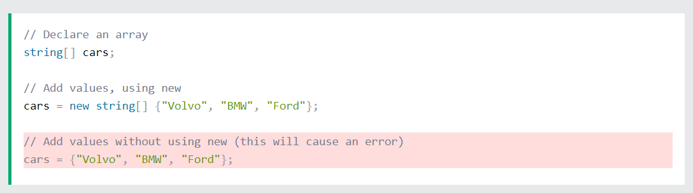
Other Ways to Create an Array

Slide 18
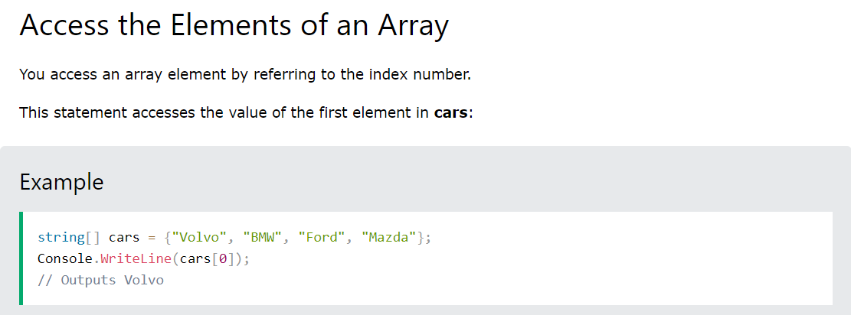
Access an Array

Slide 19
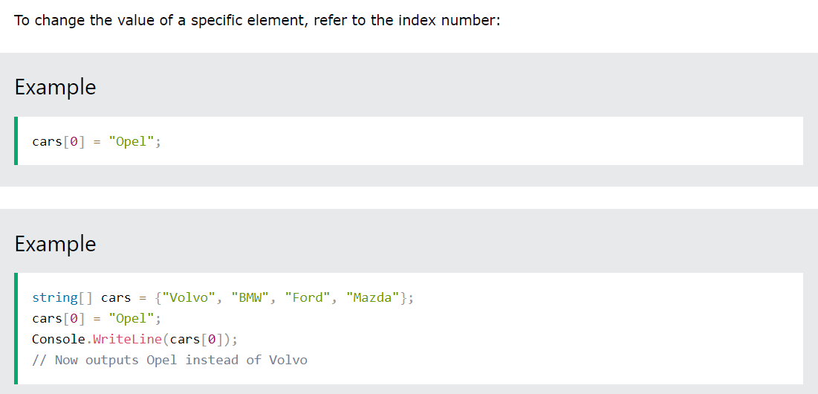
Change an Array Element

Slide 20
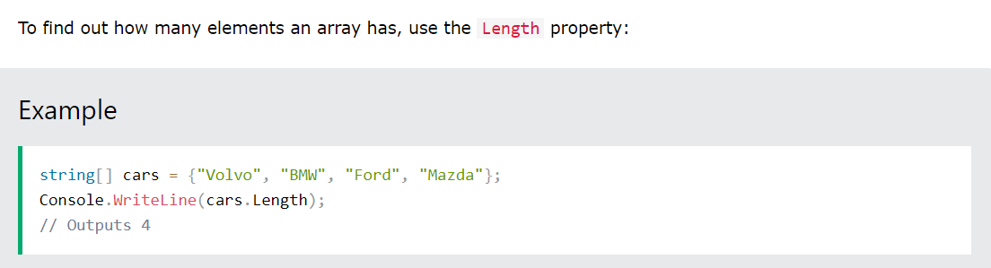
Array Length

Slide 21
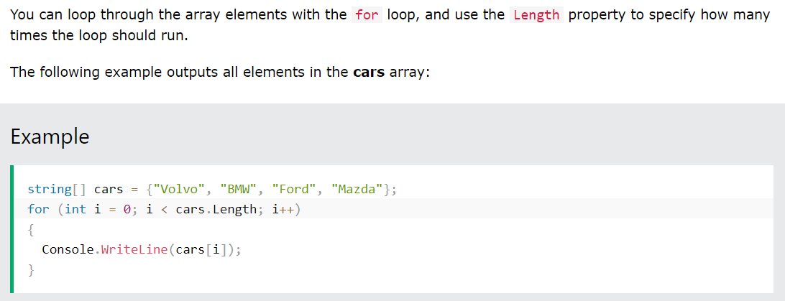
Loop Through an Array

Slide 22
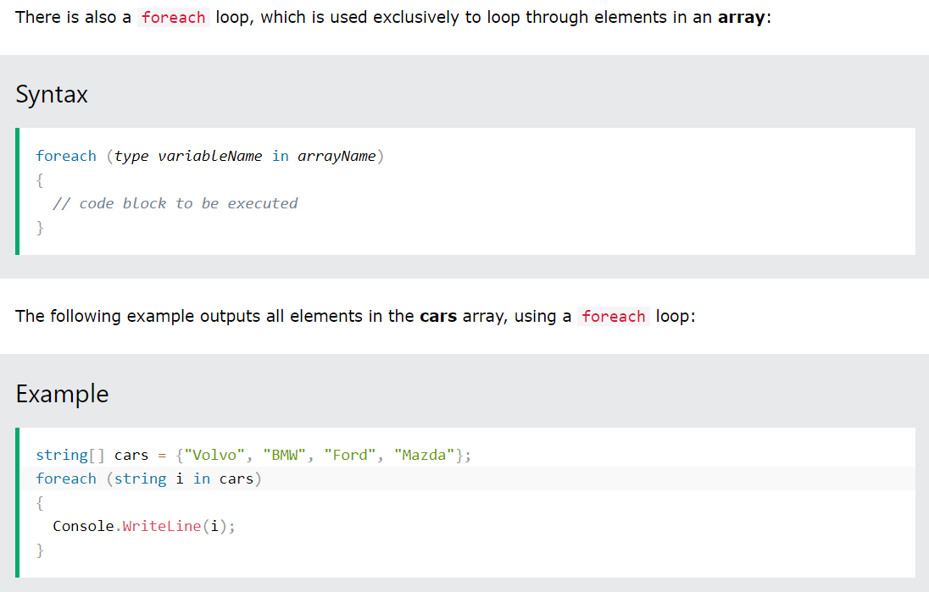
The foreach Loop

Slide 23
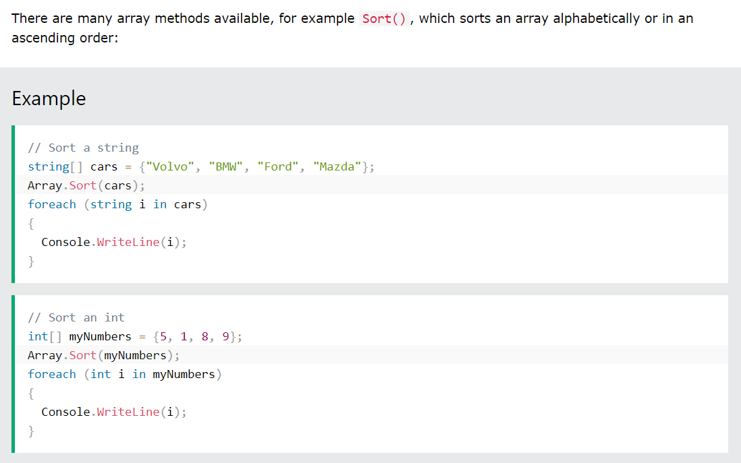
Sort Arrays

Slide 24
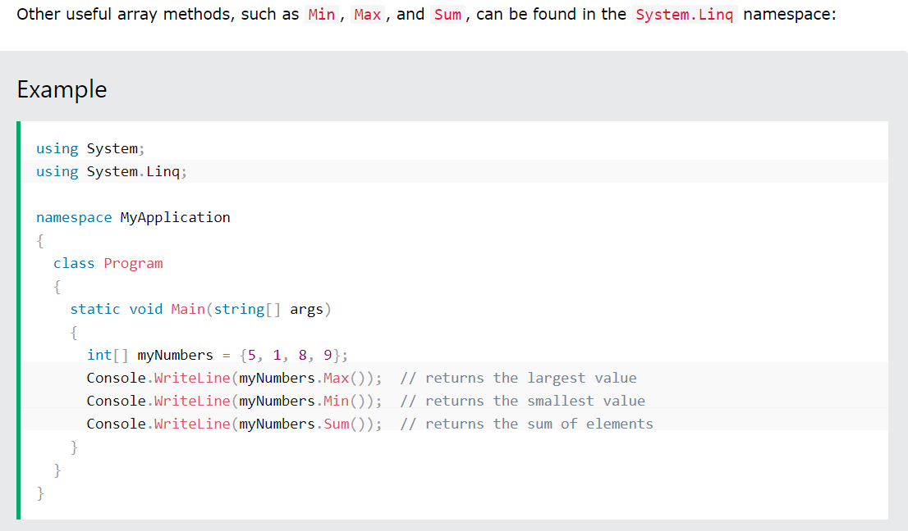
System.Linq Namespace

Slide 25
Work in class
https://www.w3schools.com/cs/exercise.php?filename=exercise_arrays1
Write a function to check if an array contains specific number
Write a function to reverse an array
Write a function to concatenate two integer arrays
Create a function that takes a string as an argument and returns a coded (h4ck3r 5p34k) version of the string. In order to work properly, the function should replace all "a"s with 4, "e"s with 3, "i"s with 1, "o"s with 0, and "s"s with 5.

Slide 26
Homework
Spaces Between Each Character
Create a function that takes a string and returns a string with spaces in between all of the characters.
Example: SpaceMeOut("space") ➞ "s p a c e“
2. Phone Number Formatting
Create a function that takes an array of 10 numbers (between 0 and 9) and returns a string of those numbers formatted as a phone number (e.g. (555) 555-5555).
3. Remove Duplicates from an Array
Create a function that takes an array of items, removes all duplicate items and returns a new array in the same sequential order as the old array (minus duplicates).
Examples:
- RemoveDups([1, 0, 1, 0]) ➞ [1, 0]
- RemoveDups(["The", "big", "cat"]) ➞ ["The", "big", "cat"]
- RemoveDups(["John", "Taylor", "John"]) ➞ ["John", "Taylor"]

Slide 27
References
https://www.w3schools.com/cs/cs_strings.php
https://www.tutorialspoint.com/csharp/csharp_strings.htm
https://www.w3schools.com/cs/cs_arrays.php
https://www.tutorialspoint.com/csharp/csharp_arrays.htm

